Slide 1
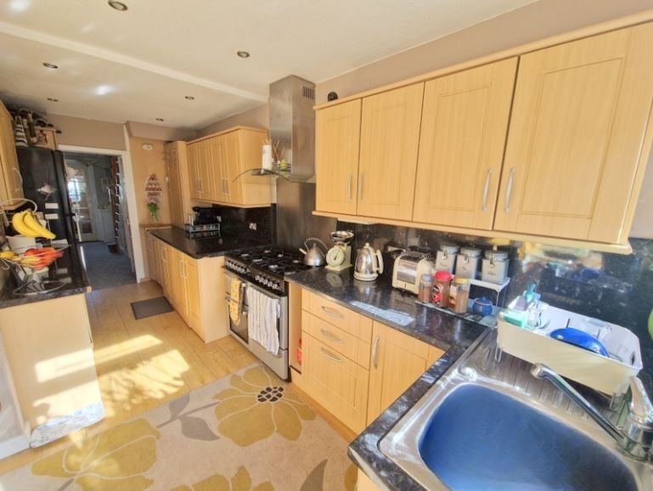
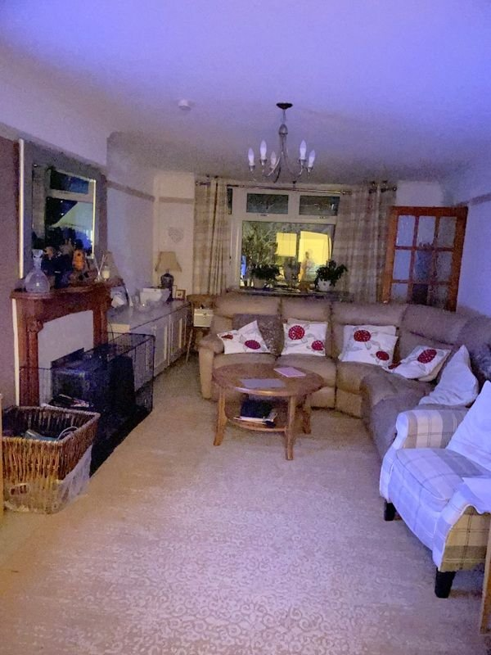
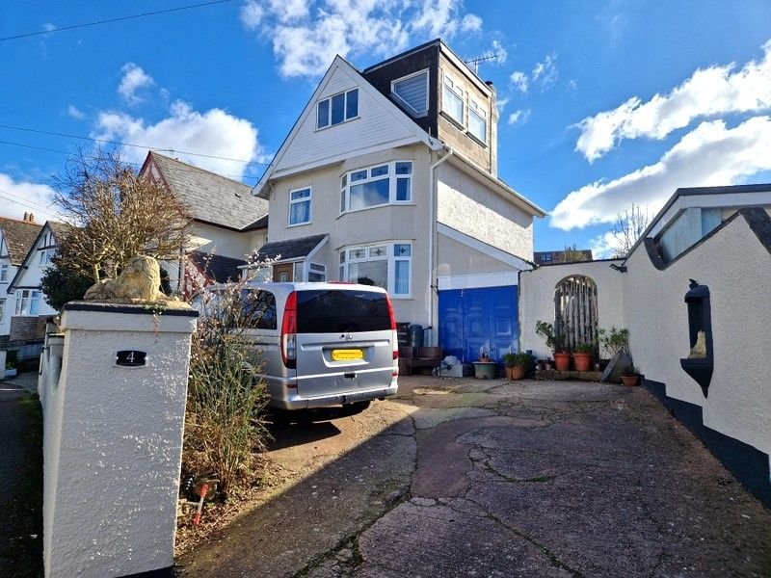
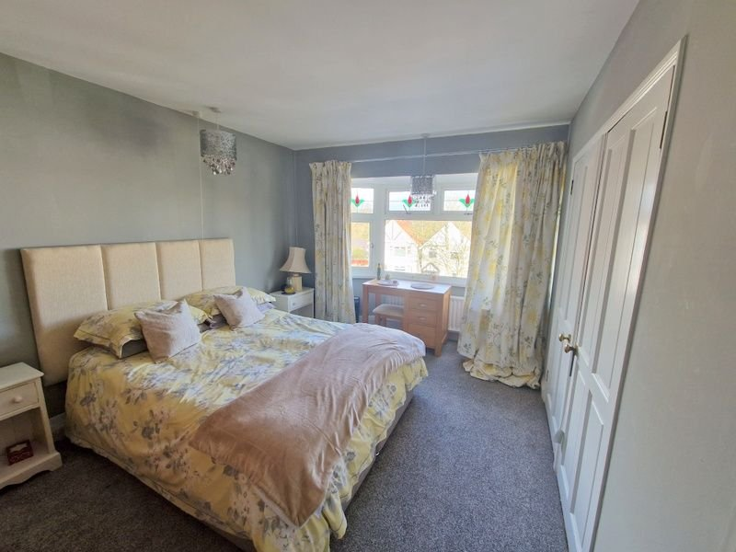
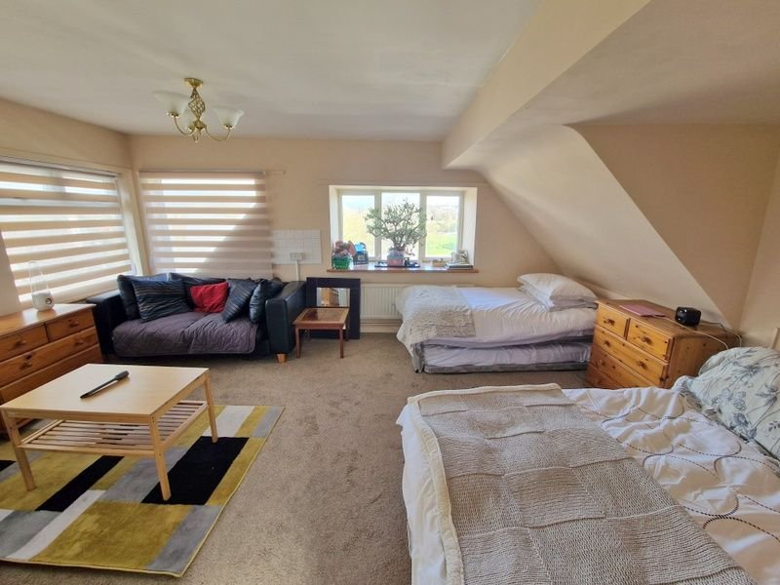
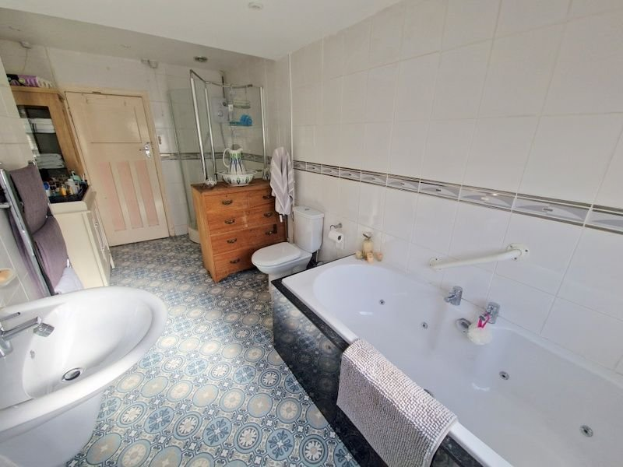
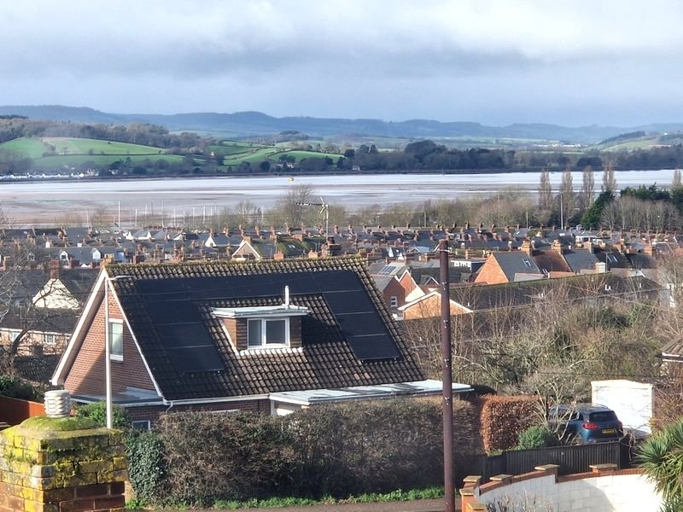
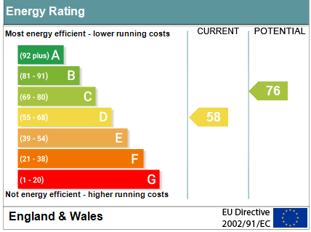
www.pennys.net
4 Ashleigh Road, Exmouth, EX8 2JY
GUIDE PRICE £530,000
TENURE Freehold
A Significantly Extended Older Style Detached House With Estuary Views Enjoying A Convenient Location Close To Amenities And Town Centre
Entrance Porch And Reception Hall • Ground Floor Cloakroom/WC •
Dining Room Opening Through To Kitchen • Spacious Lounge •
Three First Floor Bedrooms • Spacious Bathroom/WC •
Large Second Floor Bedroom Four & En-Suite Wet room/WC •
Ample Off-Road Parking, Gardens And Garage •
Close To Amenities And Town Centre • Viewing Recommended •
•
• •
Pennys Estate Agents Limited for themselves and for the vendor of this property whose agents they are give notice that:- (1) These particulars do not constitute any part of an offer or a contract. (2) All statements contained in these particulars are made without responsibility on the part of Pennys Estate Agents Limited. (3) None of the statements contained in these particulars are to be relied upon as a statement or representation of fact. (4) Any intending purchaser must satisfy himself/herself by inspection or otherwise as to the correctness of each of the statements contained in these particulars. (5) The vendor does not make or give and neither do Pennys Estate Agents Limited nor any person in their employment has any authority to make or give any representation or warranty whatever in relation to this property.
PENNYS ESTATE AGENTS
2 Rolle House, Rolle Street, Exmouth, Devon, EX8 2SN
Tel: 01395 264111 EMail: help@pennys.net

Slide 2
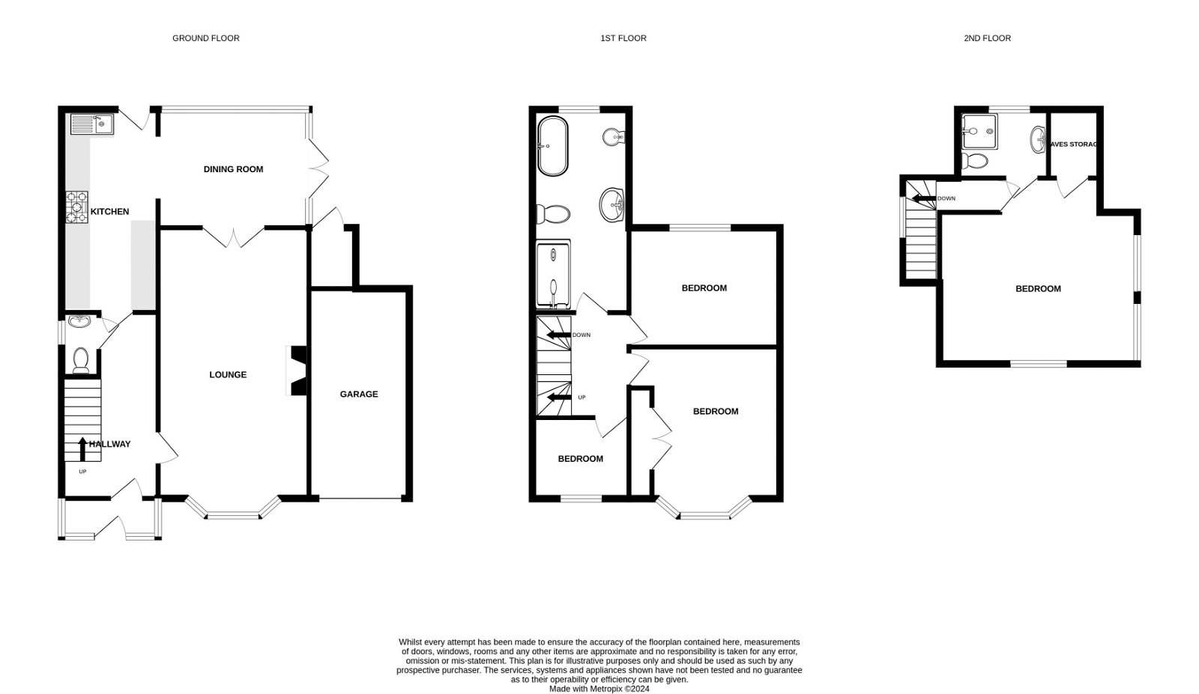
4 AshleighRoad Exmouth, EX8 2JY
THE ACCOMMODATION COMPRISES: uPVC wood effect front door: ENTRANCE PORCH: Glass panelled door to: RECEPTION HALL: Stain glass window to side aspect; stairs to first floor landing with understairs cupboard housing meters; telephone point. CLOAKROOM/WC: Wash hand basin; WC; window with pattern glass. LOUNGE: 6.71m x 3.66m (22'0" x 12'0") Double glazed bay window to front aspect; wood burner stove housed in fire surround; television point; built in cupboards; picture rail; double doors to: OPEN PLAN DINING ROOM/KITCHEN: DINING ROOM: 3.96m x 2.92m (13'0" x 9'7") Double glazed window to rear garden; double glazed double doors to outside; archway to: KITCHEN: 5.31m x 2.03m (17'5" x 6'8") Fitted with pattern worktop surfaces with splash backs; cupboards and drawer units; inset single drainer sink unit; wall mounted cupboards; fitted Flavel Aspen 100 cooker with stainless steel back and matching chimney style extractor over; double glazed window and door to outside; recess ceiling spotlighting; space for fridge freezer; plumbing for an automatic washing machine; modern boiler housed in kitchen unit. FIRST FLOOR LANDING: Double glazed window to side aspect with pattern glass; radiator; stairs to second floor landing; doors to: BEDROOM ONE: 4.44m x 3.63m (14'7" x 11'11") Double glazed bay window to front aspect with views towards the estuary and coastline; radiator; two built-in cupboards. BEDROOM TWO: 3.61m x 2.67m (11'10" x 8'9") Double glazed window to rear aspect; radiator; built-in cupboard. BEDROOM THREE: 2.34m x 1.96m (7'8" x 6'5") Double glazed window to front with estuary views; radiator. BATHROOM/WC: 4.85m x 1.98m (15'11" x 6'6") A super sized room with whirlpool bath; bidet; wash hand basin with mirror and light over; WC with push button flush; large shower cubicle with Mira shower; ceiling spotlighting; double glazed window with pattern glass; chrome heated towel rail; mirror fronted medicine cabinet. SECOND FLOOR LANDING: Double glazed window to side aspect; door to: BEDROOM FOUR: 5.08m x 4.72m (16'8" x 15'6") A wonderful dual aspect room with double glazed windows boasting views to the estuary, coastline, Phear park and across the town; radiator; eaves storage space. EN-SUITE WETROOM: 2.24m x 1.7m (7'4" x 5'7") Shower area and Mira shower; vanity wash hand basin with mirror fronted medicine cabinet; WC; part tiled walls; radiator; double glazed window; tiled splash back areas.
OUTSIDE: Pillared entrance to a large drive and turning area providing ample parking with steps up to a patio terrace area giving access to the property. Garage with up and over door. Side gates to either side of the property leading to the rear garden. The rear garden is of good size with lawn garden, mature flower and shrub beds, outside power sockets, outside lighting and outside tap. Decorative store area.

